Slide 1

UNIT – III
Derived data types and Functions in C
FYBTECH

Slide 2
Unit 3 Contents
2
Derived data types: Array- Single and Multidimensional arrays, Structure – Structure and Array of structure, Union. Strings
Functions in C: User defined and Library Functions-String Library Functions. Different parameter passing methods (Call by Value and Call by Reference), Passing array to a function, Recursion.

Slide 3
Arrays in C
3
An array is a set of elements of same datatype.
Each variable in an array is called an array element.
All the elements are of same type, but may contain different values.
The entire array is contiguously stored in memory.
The position of each array element is known as array index or subscript.

Slide 4
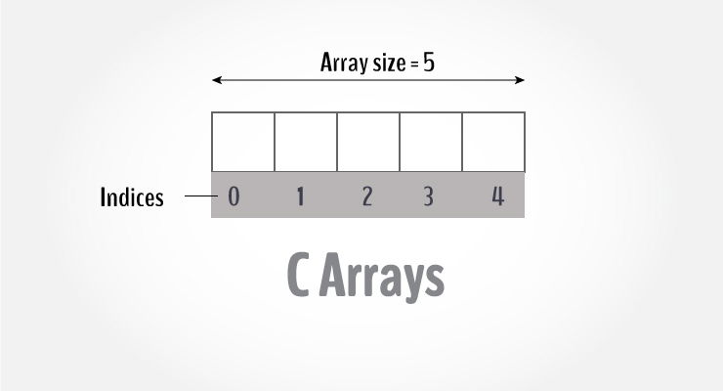
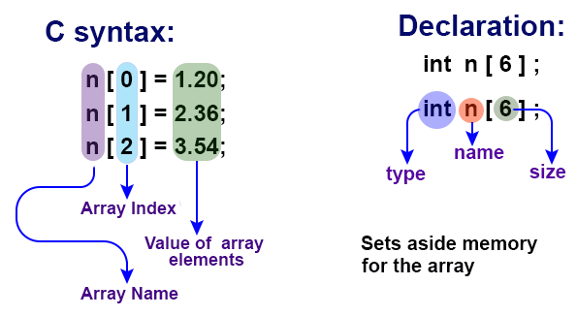
An integer array looks like this:

Slide 5
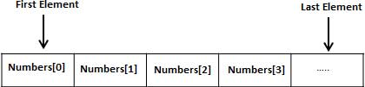
Declaring Arrays
5
In C, an array can be of any basic data type.
Example: int a[6]; //single or one dimensional array
float Salary[6];

Slide 6
Contd…
6
The array index starts with zero.
The valid array indexes for the above declared array is 0 to 5.
When an array is declared without initializing it, the elements have unknown (garbage) values.

Slide 7
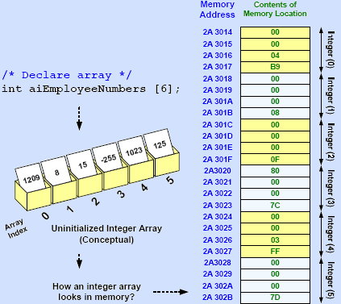
Memory Representation of an Integer Array
7

Slide 8
Declaring and Initializing Arrays
8
Arrays can be initialized as they are declared.
Example:
int aiEmployeeNumbers[ ] = {15090, 15091, 15092, 15093,15094, 15095};
The size in the above case is optional and it is automatically computed.
In the above example size of the array is 6 and it occupies 6 * 4 = 24 bytes.

Slide 9
Using Array Elements
9
An array can be accessed by giving the respective index.
Syntax:
ArrayName[index]
Example:
float afSalaries[6]; /* Declare an array of six floats */
afSalaries[0] = 12500.00; /* Assign a value to element at index 0 */
afSalaries[1] = 15000.00; /* Assign a value to element at index 1 */
...
afSalaries[5] = 25000.00; /* Assign a value to element at index 5 */

Slide 10
Contd…
10
/* Print the salary at array index 0 */
printf (“Salary at Index 0 is %f \n”, afSalaries[0]);
Arrays can also be referenced as index[ArrayName].
The statement 5[afSalaries] is a valid statement.

Slide 11
Arrays and Loops
11
#include<stdio.h>
int main()
{
#define ARRAYSIZE 10 // directive to set ARRAYSIZE to 10
int aiArray[ARRAYSIZE],iCount; //int aiArray[10];
for (iCount = 0; iCount < ARRAYSIZE; iCount++)
{ printf(“Enter %d element”,iCount);
scanf(“%d”,&aiArray[iCount]); // accept array elements
}
for (iCount = 0; iCount < ARRAYSIZE; iCount++)
{
printf(“Element in %d position %d”,iCount,aiArray[iCount]); // display
}
return 0;
}

Slide 12
Calculate average marks
for ( i = 0 ; i <= 29 ; i++ )
sum = sum + marks[ i ] ;
avg = sum / 30 ;
printf ( "Average marks = %d\n", avg ) ;

Slide 13
1.Write program to find highest number in the array.
2.Write program to add all the numbers in the array.

Slide 14
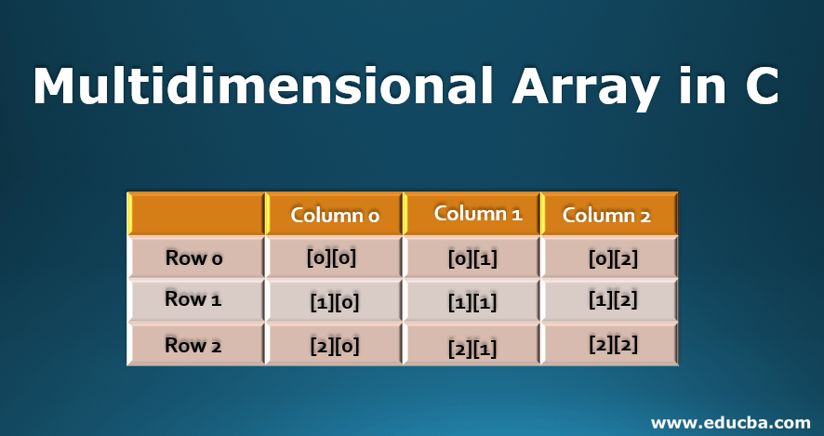
Multidimensional arrays

Slide 15
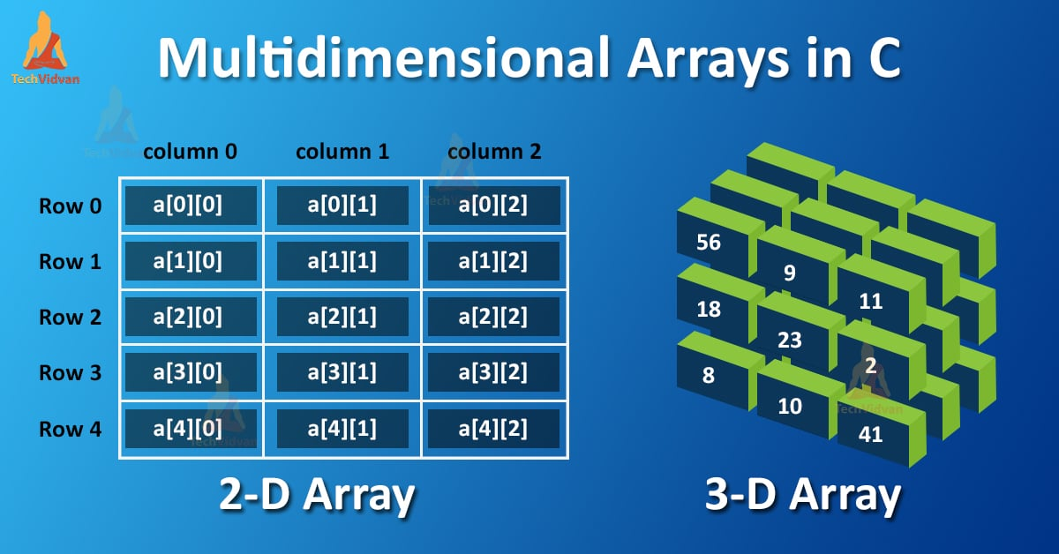
Multidimensional arrays

Slide 16
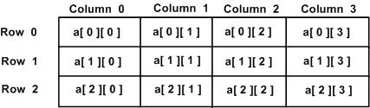
Multi dimensional Arrays:
16
The array has two subscripts. One subscript denotes the row & the other the column. The declaration of two dimension arrays is as follows:
                int arr[2][3];
Syntax :
data_type array_name[row_size][column_size];
int m[10][20];
Here m is declared as a matrix having 10 rows( numbered from 0 to 9) and 20 columns(numbered 0 through 19). The first element of the matrix is m[0][0] and the last row last column is m[9][19] .

Slide 17
Initialization Of Multidimensional Arrays
17
Like the one dimension arrays, 2 dimension arrays may be initialized by following their declaration with a list of initial values enclosed in braces.
Example:
int table[2][3]={0,0,0,1,1,1};
OR
int table[2][3]={{0,0,0},{1,1,1}}
int first[3][4] = {0,1,2,3,4,5,6,7,8,9,10,11};
int second[3][4] = {0, 1, 2, 3, 4, 5, 6, 7, 8, 9,10,11}; //a clearer definition than the first
int third[][5] = {0,1,2,3,4}; /* third[] only has one index of 1 */
int fourth[][6] = {0,1,2,3,4,5,6,7,8,9,10,11}; /* fourth[] has 2 indices - 0 or 1 */

Slide 18
Multidimensional Arrays
#include<stdio.h>
int main(){
int arr[2][2]; // Two-dimensional array declaration
int i, j;
for(i=0; i<2; i++) {
for(j=0;j<2;j++) {
printf("Enter value for arr[%d][%d]:", i, j);
scanf("%d", &arr[i][j]);
}
}
printf("Two Dimensional array elements:\n"); //Displaying array elements
for(i=0; i<2; i++) {
for(j=0;j<2;j++) {
printf("%d ", arr[i][j]);
}
printf("\n");
}
return 0;
}
18

Slide 19
Example
1.Images – captured through mobile camera etc
2D grid on screen or on print.
Internally stored as individual arrays for each of RGB
2. Sitting arrangements in classrooms, theatres etc

Slide 20
Strings
20
“A string is a series of characters in a group that occupy contiguous memory or String is an array of character.”
Example: “My Training”
“Fundamentals of Data Structure”
A string should always be enclosed with in double quotes (“)
In memory, a string ends with a null character ‘\0’ and it occupies 1 byte of memory.
Space should be allocated to store ‘\0’ as part of the string
C compiler automatically adds a NULL character '\0' to the character array created.

Slide 21
Declaration Of Strings
21
C language does not directly support string as a data type. Hence, to display a String in C, need to make use of a character array.
char variablename [Number_of_characters ];
Example: char acEmployeeName[20];
Here 20 implies that the maximum number of characters can be 19 and one position is reserved for ‘\0’
Since a character occupies one byte, the above array occupies 20 bytes (19 bytes for the employee name and one byte for ‘\0’)
/* Declaring a string as a character array */
char acInfy[ ] = “MITWPU Pune”;
Think why ‘\0’ requires only one byte!!

Slide 22
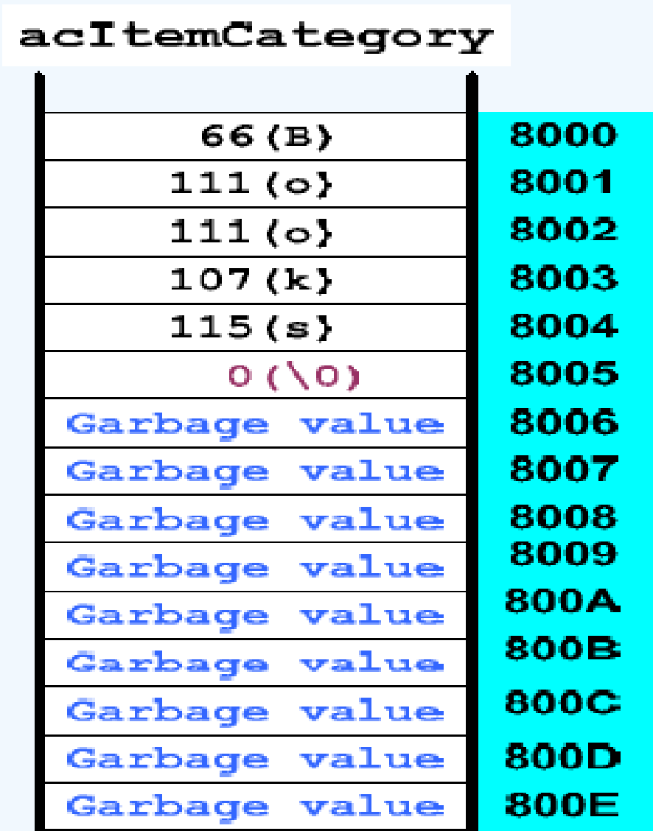
Storage Of Strings In Memory
22
char acItemCategory[15]= “Books”;

Slide 23
Static Initialization of Strings
23
char acItemCategory[15]=“Greeting Cards”;
In the above declaration, the size of the array is specified according to the number of characters in the string. One extra space for ‘\0’
char acItemCategory[15] =“Ornaments” ;
Here the size is more than the number of characters which is valid.
char acItemCategory[ ]=“Groceries”;
Here the size of the array is computed automatically which is 10. Total number of characters in the string is 9 and 1 for ‘\0’;

Slide 24
Contd…
24
char acItemCategory[3]=“Books”;
Here the size specified is 3. But the number of characters in the string is 5. This is invalid.
char acItemCategory[ ]={'s','t','a','t','i','o','n','a','r','y','\0'};
Here the character constants are supplied to initialize the string.

Slide 25
Reading and Printing Strings - Example
25
/*Program to accept Item Category and display*/
#include<stdio.h>
int main()
{ char str[15]; //character array declaration
printf("Enter the category code: ");
scanf("%s",str);
printf("The given Item Category is %s", str);
return 0;
}

Slide 26
String Handling Functions
26
The following are the string built-in functions that are supported by C
strlen() strcpy() strcat() strcmp()
These functions are defined in string.h header file.
All these functions take either a character pointer or a character array as an argument.

Slide 27
strlen() Function
27
strlen() function is used to count the number of characters in the string. Counts all the characters excluding the null character ‘\0’
Syntax:
size_t strlen (const char* s);
The strlen() function is defined in <string.h> header file.

Slide 28
Contd…
28
Example:
strlen(“Programming Fundamentals”); /*returns 24*/
strlen(acItemCategory);
returns the number of characters in the character array ‘acItemCategory’

Slide 29
Example: C strlen() function
29
#include <stdio.h>
#include <string.h>
int main() {
char a[20]="Program";
char b[20]={'P','r','o','g','r','a','m','\0'};
char c[20];
printf("Enter string: ");
gets(c); //scanf(“%s”,c);
printf("Length of string a = %d \n",strlen(a));
//calculates the length of string before null charcter.
printf("Length of string b = %d \n",strlen(b));
printf("Length of string c = %d \n",strlen(c));
return 0; }

Slide 30
strcpy() Function
30
strcpy() function is used to copy one string to another
Syntax:
strcpy (Dest_String , Source_String);
Here Dest_string should always be variable
Source_String can be a variable or a string constant

Slide 31
Contd…
31
The previous contents of Dest_String, if any, will be over written
Example:
char acCourseName[40];
strcpy(acCourseName , “C Programming”);
Now acCourseName will get the value “C Programming”

Slide 32
Example: C strcpy()
32
#include <stdio.h>
#include <string.h>
int main()
{
char str1[10]= "awesome";
char str2[10];
char str3[10];
strcpy(str2, str1); //function call
strcpy(str3, "well");
puts(str2);
puts(str3);
return 0;
}

Slide 33
strcat() Function
33
strcat() function is used to concatenate (Combine) two strings
Syntax:
strcat( Dest_String_Variable , Source_String ) ;
In this, the Destination should be a variable and Source_String can either be a string constant or a variable.
The contents of Dest_String is concatenated with Source_String contents and the resultant string is stored into Dest_String variable.

Slide 34
Contd…
34
Example:
char acTraineeFpCourse [50] = “The course is “;
strcat(acTraineeFpCourse,”Oracle 8i”);
The resultant string in acTraineeFPCourse will be
“The course is Oracle 8i”

Slide 35
Example: C strcat() function
35
#include <stdio.h>
#include <string.h>
int main()
{
char str1[] = "This is", str2[] = "MIT-WPU";
//concatenates str1 and str2 and resultant string is stored in str1.
strcat(str1,str2);
puts(str1);
puts(str2);
return 0;
}

Slide 36
strcmp() Function
36
strcmp() function is used to compare two strings
This is case sensitive
Syntax:
int strcmp( String1 , String2 )
Here both String1 and String2 can either be a variable or a string constant
strcmp() function returns an integer value.

Slide 37
Contd…
37
If strings are equal it returns zero
If the first string is alphabetically greater than the second string then it returns a positive value.
If the first string is alphabetically less than the second string then it returns a negative value.
Example:
strcmp(“My Work”, “My Job”) returns a positive value.

Slide 38
Contd…
38
If strings are equal it returns zero
If the first string is alphabetically greater than the second string then it returns a positive value.
If the first string is alphabetically less than the second string then it returns a negative value.
Example:
strcmp(“My Work”, “My Job”) returns a positive value

Slide 39
Example: C strcmp() function
39
#include <stdio.h>
#include <string.h>
int main() {
char str1[] = "abcd", str2[] = "abCd", str3[] = "abcd";
int result;
// comparing strings str1 and str2
result = strcmp(str1, str2);
printf("strcmp(str1, str2) = %d\n", result);
// comparing strings str1 and str3
result = strcmp(str1, str3);
printf("strcmp(str1, str3) = %d\n", result);
return 0;
}

